Slide 1

BRANDON DAVID MEZA VARGAS
-----------------------------------------------------------
PROBLEMA 3.63

Slide 2
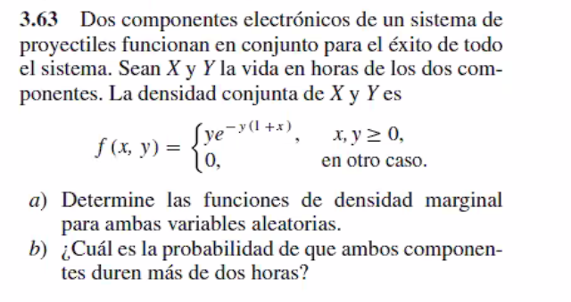


Slide 3
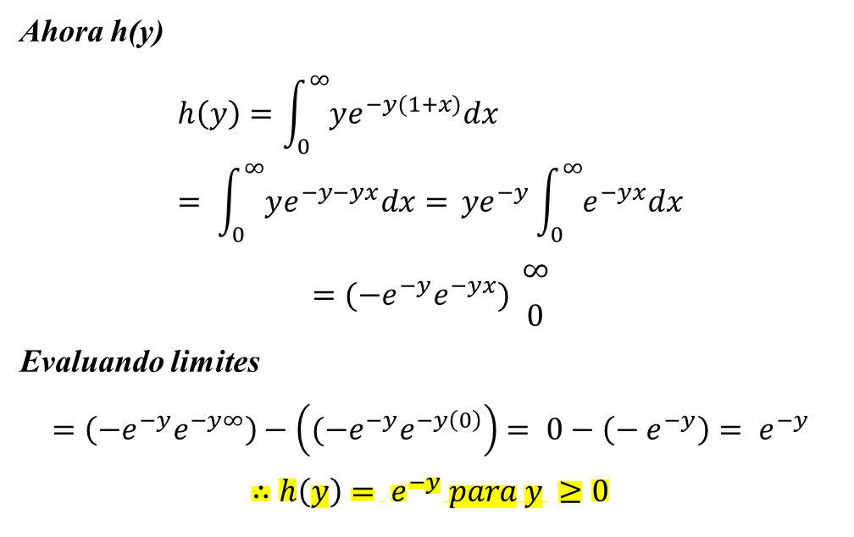
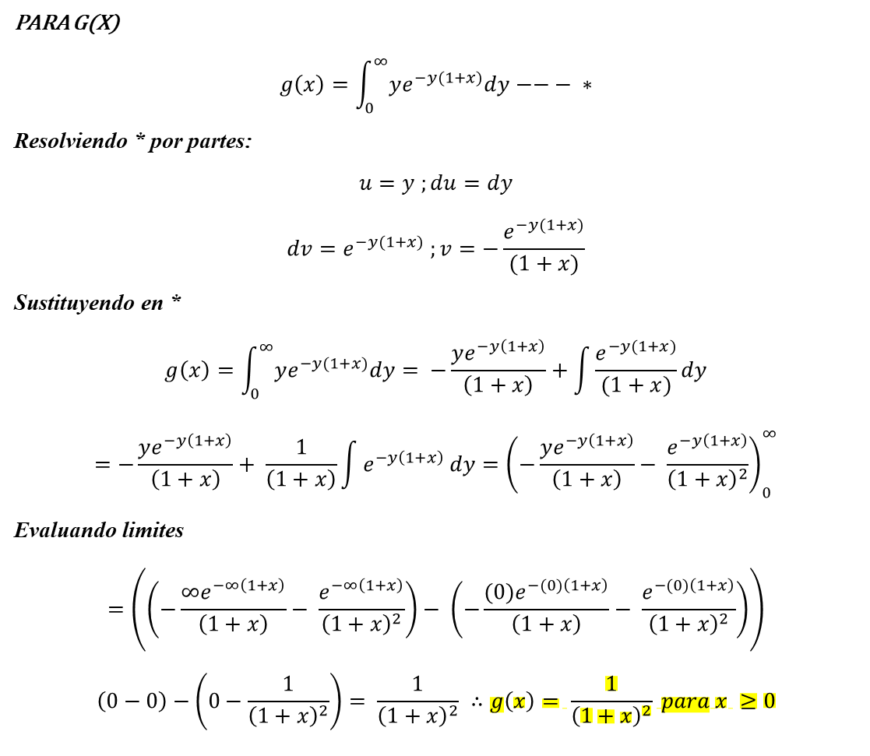
a)
PARA G(X)
$$g\left(x\right)=\int_{0}^{∞}{ye^{−y(1+x)}dy}−−− ∗$$
Resolviendo * por partes:
$$u=y ;du=dy$$
$$dv=e^{−y(1+x)} ;v=−\frac{e^{−y(1+x)}}{(1+x)}$$
Sustituyendo en *
$$g\left(x\right)=\int_{0}^{∞}{ye^{−y(1+x)}dy}= −\frac{ye^{−y\left(1+x\right)}}{\left(1+x\right)}+\int{\frac{e^{−y(1+x)}}{(1+x)}}dy$$
$$=−\frac{ye^{−y\left(1+x\right)}}{\left(1+x\right)}+ \frac{1}{\left(1+x\right)}\int{e^{−y\left(1+x\right)} dy}={\left(−\frac{ye^{−y\left(1+x\right)}}{\left(1+x\right)}− \frac{e^{−y\left(1+x\right)}}{{\left(1+x\right)}^{2}}\right)}_{0}^{∞}$$
Evaluando limites
$$=\left(\left(−\frac{∞e^{−∞\left(1+x\right)}}{\left(1+x\right)}− \frac{e^{−∞\left(1+x\right)}}{{\left(1+x\right)}^{2}}\right)− \left(−\frac{(0)e^{−(0)\left(1+x\right)}}{\left(1+x\right)}− \frac{e^{−(0)\left(1+x\right)}}{{\left(1+x\right)}^{2}}\right)\right)$$
$$\left(0−0\right)−\left(0−\frac{1}{{\left(1+x\right)}^{2}}\right)= \frac{1}{{\left(1+x\right)}^{2}} ∴g\left(x\right)= \frac{1}{{\left(1+x\right)}^{2}} para x ≥0$$
Ahora h(y)
$$h\left(y\right)=\int_{0}^{∞}{ye^{−y(1+x)}dx}= \int_{0}^{∞}{ye^{−y−yx}dx= }ye^{−y}\int_{0}^{∞}{e^{−yx}dx}$$
$$={(−e}^{−y}e^{−yx}) {∞ \atop 0}$$
Evaluando limites
$$=\left({−e}^{−y}e^{−y∞}\right)−\left({(−e}^{−y}e^{−y\left(0\right)}\right)= 0−\left(− e^{−y}\right)= e^{−y}$$
$$∴h\left(y\right)= e^{−y} para y ≥0$$

Slide 4
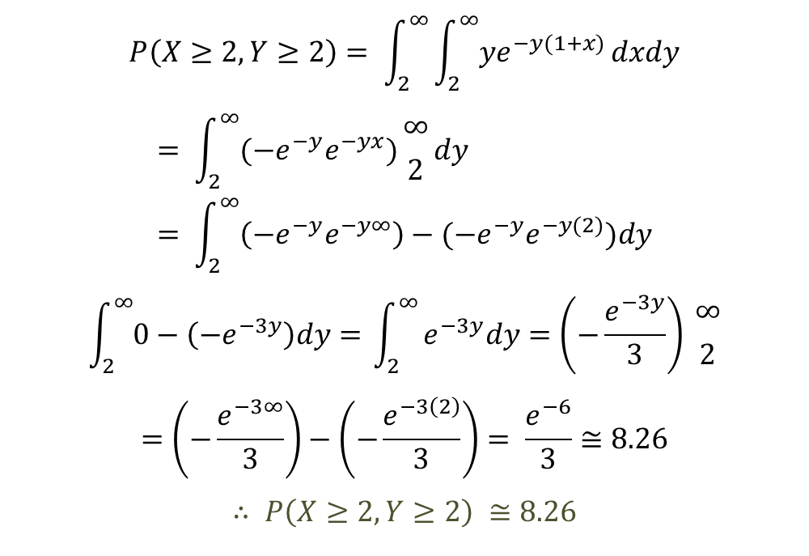
b)
$$P\left(X≥2,Y≥2\right)= \int_{2}^{∞}{\int_{2}^{∞}{ye^{−y(1+x)}}dxdy}$$
$$= \int_{2}^{∞}{({−e}^{−y}e^{−yx})}{∞ \atop 2}dy= \int_{2}^{∞}{\left({−e}^{−y}e^{−y∞}\right)−({−e}^{−y}e^{−y(2)})dy}$$
$$\int_{2}^{∞}{0−\left(−e^{−3y}\right)dy= }\int_{2}^{∞}{e^{−3y}dy=\left(−\frac{e^{−3y}}{3}\right) {∞ \atop 2}}$$
$$=\left(−\frac{e^{−3∞}}{3}\right)−\left(−\frac{e^{−3\left(2\right)}}{3}\right)= \frac{e^{−6}}{3}≅8.26$$
$$∴ P\left(X≥2,Y≥2\right) ≅8.26$$

